Slide 1
Complexity of Problems
Xu Yanyan

Slide 2
Complexity of Problems
NP-Complete Problems
The Decision Tree Model for Lower Bounds

Slide 3
The computational complexity of a problem
Define the computational complexity of a problem to be the computational complexity of the most efficient algorithm to solve the problem.

Slide 4
1. NP-Complete Problems
1.1 Decision Problem & Optimization Problem
1.2 The Class P
1.3 The Class NP
1.4 NP-Complete Problems

Slide 5
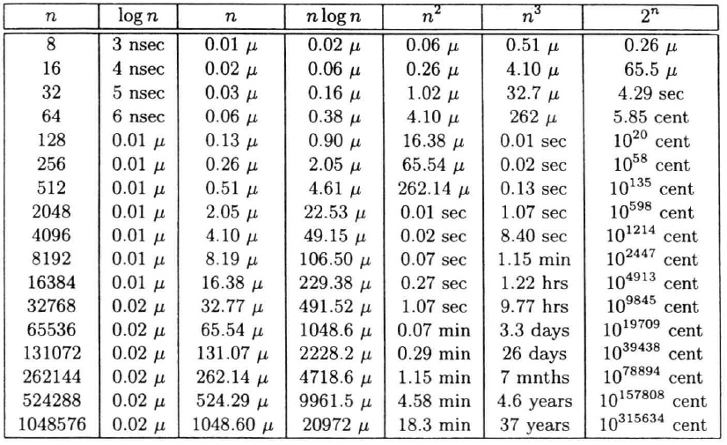
Order of growth
assuming that each operation takes one nanosecond (nsec, 10⁻⁹s). μ means millisecond (10⁻³s).

Slide 6
1.1.1 Decision Problem
In computability theory and computational complexity theory, a decision problem is a problem that can be posed as a yes-no question of the input values. An example of a decision problem is deciding whether a given natural number is prime. A decision problem which can be solved by an algorithm is called decidable.
The halting problem is the problem of determining, from a description of an arbitrary computer program and an input, whether the program will finish running, or continue to run forever. Alan Turing proved in 1936 that a general algorithm to solve the halting problem for all possible program-input pairs cannot exist. The halting problem is an important undecidable decision problem.

Slide 7
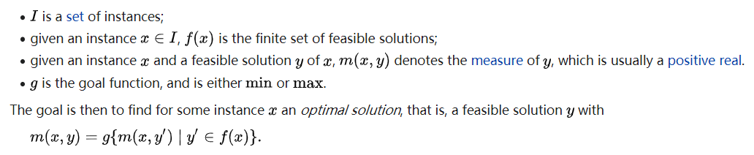
1.1.2 Optimization Problem
An optimization problem is the problem of finding the best solution from all feasible solutions.
Formally, a combinatorial optimization problem A is a quadruple (I,f,m,g), where
For each combinatorial optimization problem, there is a corresponding decision problem that asks whether there is a feasible solution for some particular measure m₀.

Slide 8
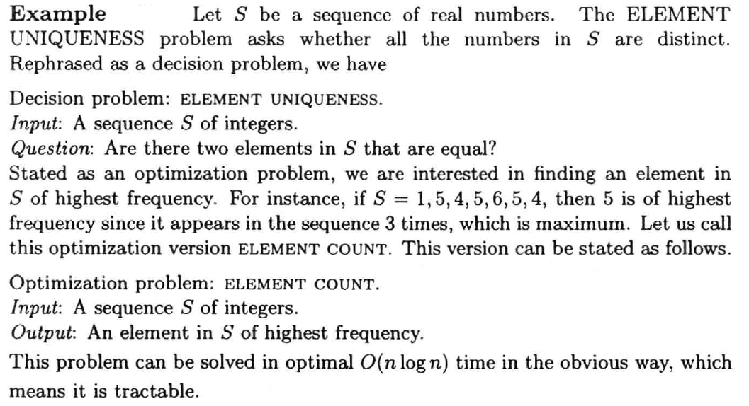

Slide 9
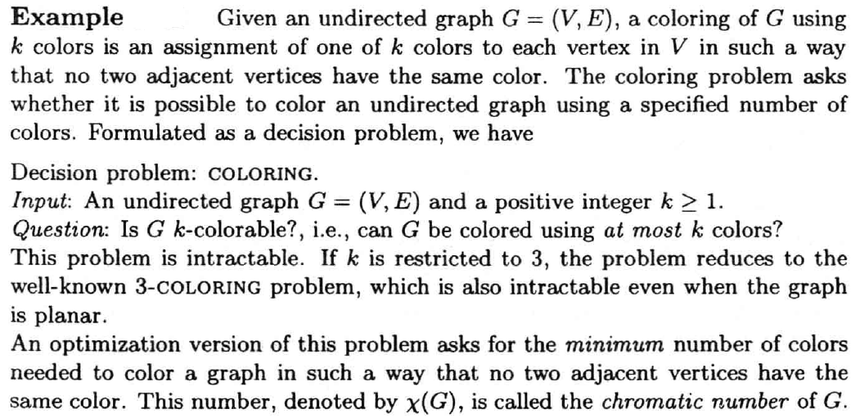
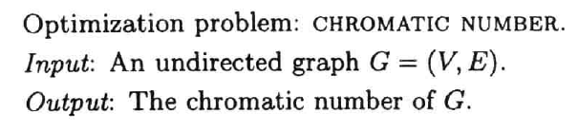
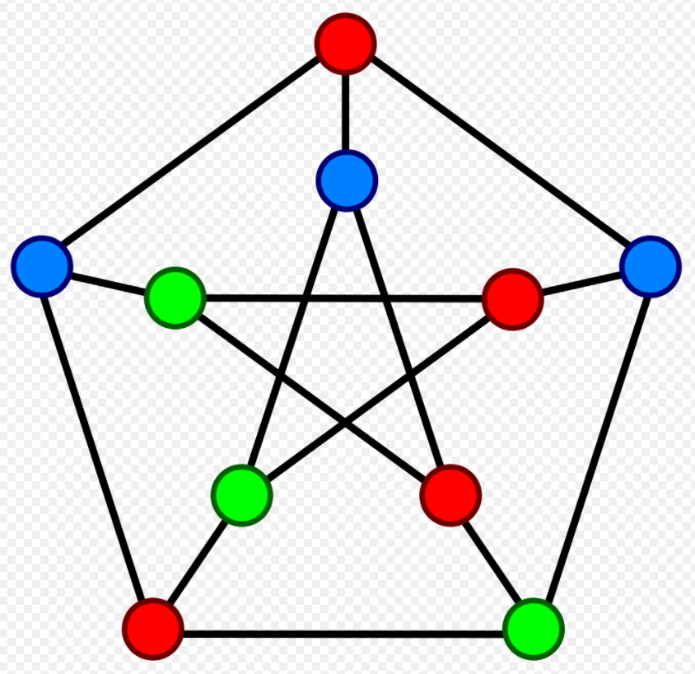

Slide 10
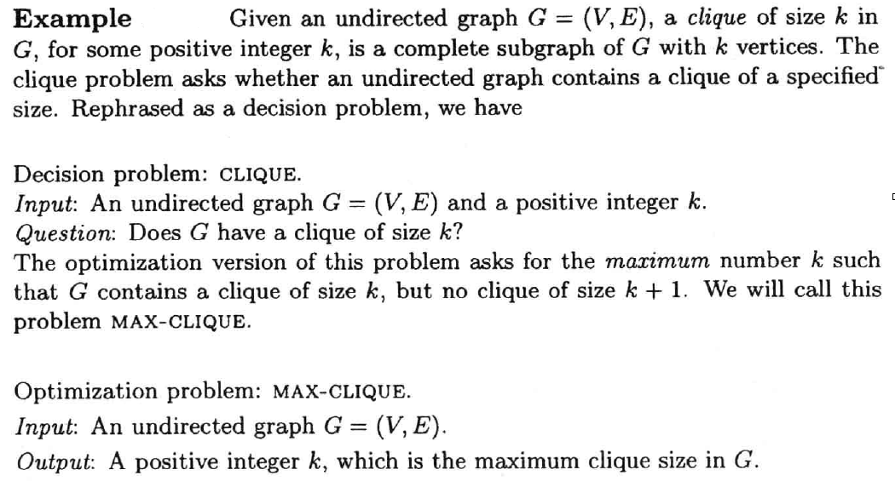
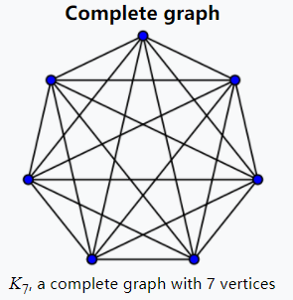
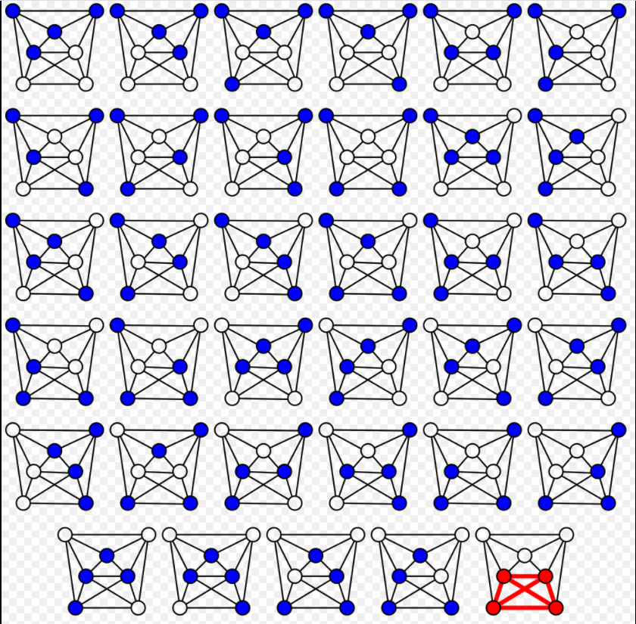
The brute force algorithm finds a 4-clique in this 7-vertex graph by systematically checking all C(7,4) = 35 4-vertex subgraphs for completeness.

Slide 11
If we have an efficient algorithm that solves a decision problem, then it can easily be modified to solve its corresponding optimization problem.
For instance, if we have an algorithm A that solves the decision problem for graph coloring, we can find the chromatic number of a graph G using binary search and Algorithm A as a subroutine. Clearly, 1 < χ(G) <n，where n is the number of vertices in G. Hence, the chromatic number of G can be found using only O(logn) calls to algorithm A.
Since we are dealing with polynomial time algorithms, the log n factor is inconsequential. Because of this reason, in the study of NP-complete problems, and computational complexity or even computability in general, it is easier to restrict one’s attention to decision problems.

Slide 12
1.2 The Class P
P is a fundamental complexity class. It contains all decision problems that can be solved by a deterministic Turing machine using a polynomial amount of computation time, or polynomial time.
A formal language L is in P if and only if there exists a deterministic Turing machine M, such that
M runs for polynomial time on all inputs
For all х in L, M outputs 1
For all х not in L, M outputs 0

Slide 13
Formal Language
A formal language consists of words whose letters are taken from an alphabet and are well-formed according to a specific set of rules.
The following rules describe a formal language L over the alphabet Σ = {0, 1, 2, 3, 4, 5, 6, 7, 8, 9, +, =}:
Every nonempty string that does not contain "+" or "=" and does not start with "0" is in L.
The string "0" is in L.
A string containing "=" is in L if and only if there is exactly one "=", and it separates two valid strings of L.
A string containing "+" but not "=" is in L if and only if every "+" in the string separates two valid strings of L.
No string is in L other than those implied by the previous rules.
Under these rules, the string "23+4=555" is in L, but the string "=234=+" is not. This formal language expresses natural numbers, well-formed additions, and well-formed addition equalities, but it expresses only what they look like (their syntax), not what they mean (semantics).

Slide 14
Turing Machine (1936 by Alan Turing)
A Turing machine is a mathematical model of computation that defines an abstract machine that manipulates symbols on a strip of tape according to a table of rules. (An example of one of a Turing Machine's rules might thus be: "If you are in state 2 and you see an 'A', change it to 'B', move left, and change to state 3.“)
Despite the model's simplicity, given any computer algorithm, a Turing machine capable of simulating that algorithm's logic can be constructed.

Slide 15
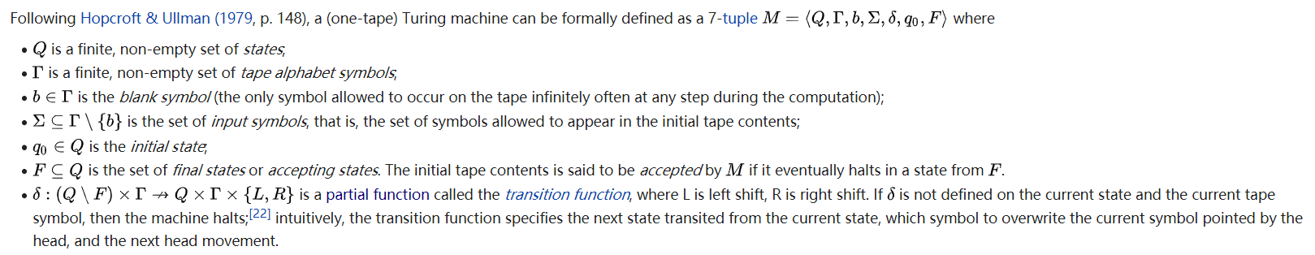
Formal Definition of the (Deterministic ) Turing Machine

Slide 16
Deterministic Turing machine
In a deterministic Turing machine (DTM), the set of rules prescribes at most one action to be performed for any given situation.

Slide 17
Notable problems in P
Sorting
Shortest Path
Set Disjointness
2-coloring (bipartite graph, BFS or DFS)
2-SAT
…
Tarjan: Strongly connected components, linear time

Slide 18
1.3 The Class NP
In computational complexity theory, NP (nondeterministic polynomial time) is a complexity class used to classify decision problems. NP is the set of decision problems for which the problem instances, where the answer is "yes", have proofs verifiable in polynomial time by a deterministic Turing machine, or alternatively the set of problems that can be solved in polynomial time by a nondeterministic Turing machine.
The nondeterministic algorithm consists of two phases, the first of which consists of a guess about the solution, which is generated in a non-deterministic way, while the second phase consists of a deterministic algorithm that verifies if the guess is a solution to the problem.

Slide 19
Nondeterministic Turing machine
A nondeterministic Turing machine (NTM) is a theoretical model of computation in which governing rules specify more than one possible action when in some given situations. That is, an NTM's next state is not completely determined by its action and the current symbol it sees, unlike a deterministic Turing machine.

Slide 20
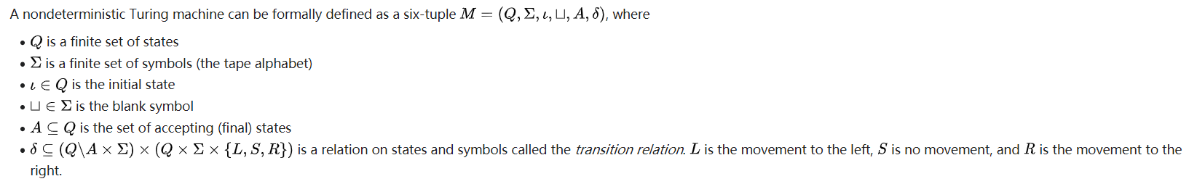
Formal Definition of the Nondeterministic Turing Machine
⊔ square cup
The difference with a standard (deterministic) Turing machine is that, for deterministic Turing machines, the transition relation is a function rather than just a relation.

Slide 21

P & NP
P is the class of decision problems that we can decide or solve using a deterministic algorithm that runs in polynomial time.
NP is the class of decision problems that we can check or verify their solution using a deterministic algorithm that runs in polynomial time.
P=NP ?

Slide 22
1.4 NP-Complete Problems

Slide 23
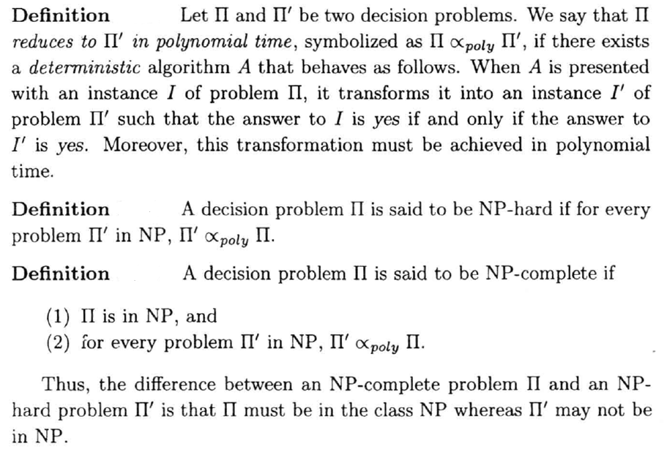
1.4.1 NP-Complete & NP-Hard

Slide 24
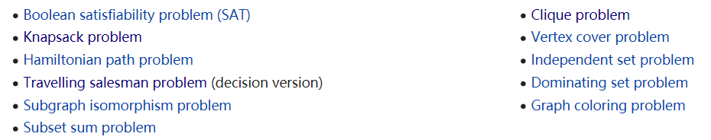
1.4.2 NP-Complete Problems
The easiest way to prove that some new problem is NP-complete is first to prove that it is in NP, and then to reduce some known NP-complete problem to it.
The list below contains some well-known problems that are NP-complete when expressed as decision problems.

Slide 25
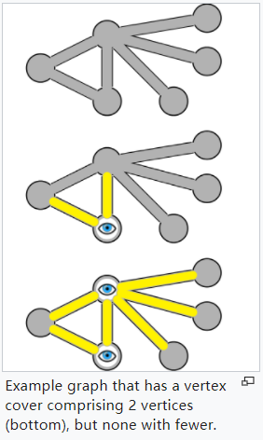
The Vertex Cover Problem
A vertex cover of a graph is a set of vertices that includes at least one endpoint of every edge of the graph. The problem of finding a minimum vertex cover is a classical optimization problem in computer science and is a typical example of an NP-hard optimization problem. Its decision version, the vertex cover problem is a classical NP-complete problem in computational complexity theory.

Slide 26
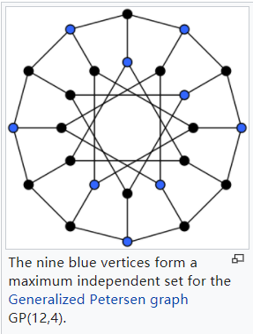
The Independent Set Problem
In graph theory, an independent set, is a set of vertices in a graph, no two of which are adjacent. That is, it is a set S of vertices such that for every two vertices in S, there is no edge connecting the two. Equivalently, each edge in the graph has at most one endpoint in S.
A set is independent if and only if it is a clique in the graph’s complement.

Slide 27
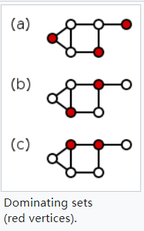
The Dominating Set Problem
A dominating set for a graph G = (V, E) is a subset D of V such that every vertex not in D is adjacent to at least one member of D. The domination number γ(G) is the number of vertices in a smallest dominating set for G.

Slide 28
The Subgraph Isomorphism Problem
The subgraph isomorphism problem is a computational task in which two graphs G and H are given as input, and one must determine whether G contains a subgraph that is isomorphic to H.

Slide 29
The Subset Sum Problem
The subset sum problem is a decision problem in computer science. In its most general formulation, there is a multiset S of integers and a capacity T, and the question is to decide whether any subset of the integers sum to precisely T.
For example, given the set {-7,-3,-2,9000,5,8} and T=0, the answer is yes because the subset {-3,-2,5} sums to zero.

Slide 30
2. The Decision Tree Model for Lower Bounds
In computational complexity the decision tree model is the model of computation in which an algorithm is considered to be basically a decision tree.
A decision tree is a decision support tool that uses a tree-like model of decisions and their possible consequences.

Slide 31
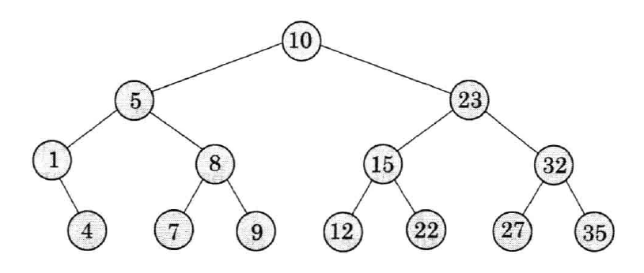
A Decision Tree for Binary Search

Slide 32
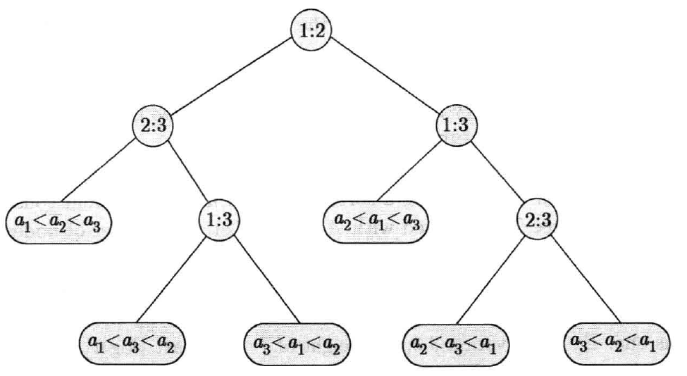
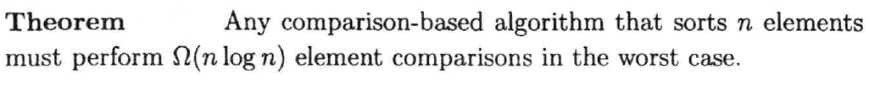
A Decision Tree for Sorting

